Slide 1
Three-Dimensional Site Response Analysis of Sloping Ground
Jubin kumar soni

Slide 2
INTRODUCTION
The considered site consists of layered cohesionless soil underlain by bedrock.
The slope has a 2% grade perpendicular to the direction of shaking.
The model consists of a single column of 3D brick elements supported vertically at the base.
Boundary conditions are applied in both horizontal directions.

Slide 3
The velocity time history of the selected earthquake record, yerbaNSvelocity.out (required for analysis)
Results_mat.m is a file in which all the plotting related code for matlab is written.

Slide 4
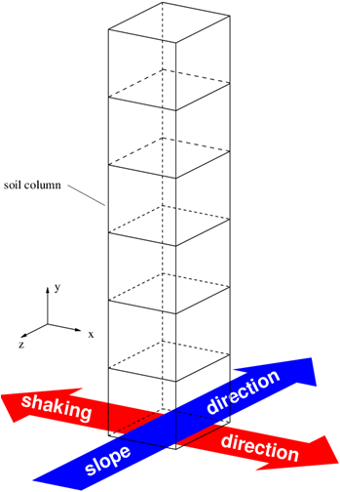
Model Description
The site response analysis discussed in this article is for a soil profile consisting of a 10 m thick layer of loose sand above a 20 m thick layer of more dense sand.
The profile is assumed to be on an infinite slope with a 2% grade.

Slide 5
The groundwater table is located at a depth of 2 m.
Earthquake excitation is applied in the direction perpendicular to the slope.

Slide 6
Mesh Geometry
A single column of 8-node brick elements is created based off of the input information.
The vertical direction for this column is oriented with the global y-direction, and the elements are sized equally in the global x- and z-directions.
The shaking is applied in the x-direction and the slope is in the z-direction.

Slide 7
Boundary Conditions
The column of elements is supported vertically at the base. Periodic boundary conditions are applied in the global x- and z-directions using the equalDOF command.
Dashpots are applied at the base of the column in the global x- and z-directions to simulate the underlying bedrock layer .
The viscous uniaxial material is used with zeroLength elements to define the dashpots.

Slide 8
Material and Element Definitions
The soil constitutive behavior is modeled using the PressureDependMultiYield02 nDMaterial object. The default material parameters are based upon the recommended table of parameters available on the PressureDependMultiYield02 page for the appropriate relative densities.
The mass density input values for the material objects should be total mass densities, i.e. above the groundwater table, the mass density should reflect dry or moist conditions, and below the groundwater table, the mass density should be the saturated value.
The SSPbrickUP element is used in this example. This element uses a u-p formulation to consider the coupling between the solid and fluid phases of the soil mixture.

Slide 9
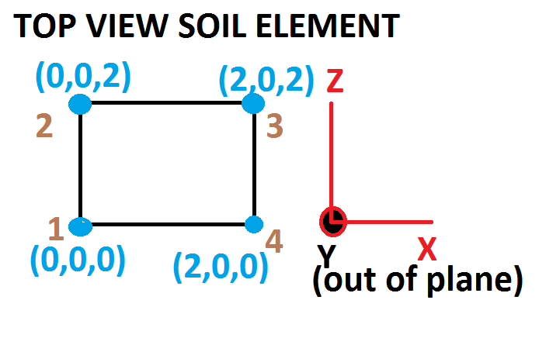
NUMBERING OF NODES

Slide 10
Additional file required
nodeInfo.dat is required in which all the information regarding soil nodes are given (1st row -> origin)
(2nd row -> along z)
(3rd row -> along z-x)
(4th row -> along x)

Slide 11
elementInfo.dat is required to give all node connectivity in a particular layer
(each row containing all node numbers space gaped for a particular element)
EXAMPLE code snippet:-
(1 1 2 3 4 5 6 7 8)
Eight nodes in one row because each element has 8nodes

Slide 12
1. DEFINE ANALYSIS PARAMETERS
set soilThick 30.0 # thickness of soil profile (m)
set grade 2.0 # grade of slope (%)
set numLayers 3 # number of soil layers
# layer thicknessess (m)
set layerThick(3) 2.0
set layerThick(2) 8.0
set layerThick(1) 20.0
# depth of water table
set waterTable 2.0

Slide 13
# define layer boundaries
set layerBound(1) $layerThick(1)
for {set i 2} {$i <= $numLayers} {incr i 1} {
set layerBound($i) [expr $layerBound([expr $i-1])+$layerThick($i)]
}

Slide 14
#---MESH GEOMETRY
# number of elements in horizontal direction
set nElemX 1
set nElemZ 1
# number of nodes in horizontal direction
set nNodeX [expr 2*$nElemX+1]
# horizontal element size (m)
set sElemX 2.0
set sElemZ 2.0

Slide 15
# number of elements in vertical direction for each layer
set nElemY(3) 4
set nElemY(2) 16
set nElemY(1) 40
# total number of elements in vertical direction
set nElemT 60
# vertical element size in each layer
for {set i 1} {$i <=$numLayers} {incr i 1} {
set sElemY($i) [expr $layerThick($i)/$nElemY($i)]
puts "size: $sElemY($i)"
}

Slide 16
# number of nodes in vertical direction in each layer
set nNodeT 0
for {set k 1} {$k < $numLayers} {incr k 1} {
set nNodeY($k) [expr 4*$nElemY($k)]
puts "number of nodes in layer $k: $nNodeY($k)"
set nNodeT [expr $nNodeT + $nNodeY($k)]
}
set nNodeY($numLayers) [expr 4*($nElemY($numLayers) + 1)]
puts "number of nodes in layer $numLayers: $nNodeY($numLayers)"
set nNodeT [expr $nNodeT + $nNodeY($numLayers)]
puts "total number of nodes: $nNodeT"

Slide 17
2. CREATE SOIL NODES AND BOUNDARY CONDITIONS
model BasicBuilder -ndm 3 -ndf 4
#Initialization
set yCoord 0.0
set count 0
set gwt 1
set waterHeight [expr $soilThick-$waterTable]
set nodesInfo [open nodesInfo.dat w]

Slide 18
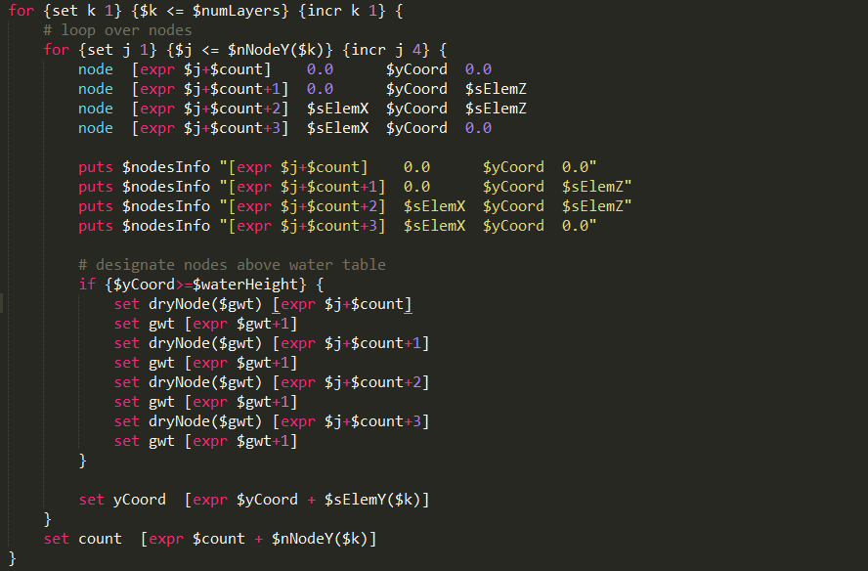

Slide 19
fix 1 0 1 1 0
fix 2 0 1 1 0
fix 3 0 1 1 0
fix 4 0 1 1 0
equalDOF 1 2 1
equalDOF 1 3 1
equalDOF 1 4 1
# define periodic boundary conditions for remaining nodes
set count 0
for {set k 5} {$k <= [expr $nNodeT]} {incr k 4} {
equalDOF $k [expr $k+1] 1 2 3
equalDOF $k [expr $k+2] 1 2 3
equalDOF $k [expr $k+3] 1 2 3
}
# define pore pressure boundaries for nodes above water table
for {set i 1} {$i < $gwt} {incr i 1} {
fix $dryNode($i) 0 0 0 1
}

Slide 20
4. CREATE SOIL MATERIALS
set slope [expr atan($grade/100.0)]
set g -9.81
nDMaterial PressureDependMultiYield02 3 3 1.8 9.0e4 2.2e5 32 0.1 \
101.0 0.5 26 0.067 0.23 0.06 \
0.27 20 5.0 3.0 1.0 \
0.0 0.77 0.9 0.02 0.7 101.0
set xWgt(3) 0.0
set yWgt(3) [expr $g*cos($slope)]
set zWgt(3) [expr $g*sin($slope)]
set uBulk(3) 2.2e6
set xPerm(3) 1.0e-2
set yPerm(3) 1.0e-2
set zPerm(3) 1.0e-2
set eVoid(3) 0.77

Slide 21
nDMaterial PressureDependMultiYield02 2 3 2.24 9.0e4 2.2e5 32 0.1 \
101.0 0.5 26 0.067 0.23 0.06 \
0.27 20 5.0 3.0 1.0 \
0.0 0.77 0.9 0.02 0.7 101.0
set xWgt(2) 0.0
set yWgt(2) [expr $g*cos($slope)]
set zWgt(2) [expr $g*sin($slope)]
set uBulk(2) 2.2e6
set xPerm(2) 1.0e-5
set yPerm(2) 1.0e-5
set zPerm(2) 1.0e-5
set eVoid(2) 0.77

Slide 22
nDMaterial PressureDependMultiYield02 1 3 2.45 1.3e5 2.6e5 39 0.1 \
101.0 0.5 26 0.010 0.0 0.35 \
0.0 20 5.0 3.0 1.0 \
0.0 0.47 0.9 0.02 0.7 101.0
set xWgt(1) 0.0
set yWgt(1) [expr $g*cos($slope)]
set zWgt(1) [expr $g*sin($slope)]
set uBulk(1) 2.2e6
set xPerm(1) 1.0e-2
set yPerm(1) 1.0e-2
set zPerm(1) 1.0e-2
set eVoid(1) 0.47

Slide 23
nDMaterial PressureDependMultiYield02 1 3 2.45 1.3e5 2.6e5 39 0.1 \
101.0 0.5 26 0.010 0.0 0.35 \
0.0 20 5.0 3.0 1.0 \
0.0 0.47 0.9 0.02 0.7 101.0
set xWgt(1) 0.0
set yWgt(1) [expr $g*cos($slope)]
set zWgt(1) [expr $g*sin($slope)]
set uBulk(1) 2.2e6
set xPerm(1) 1.0e-2
set yPerm(1) 1.0e-2
set zPerm(1) 1.0e-2
set eVoid(1) 0.47

Slide 24
5. CREATE SOIL ELEMENTS
set alpha 1.5e-6
set count 0
set elemInfo [open elementInfo.dat w]

Slide 25
# loop over layers
for {set k 1} {$k <= $numLayers} {incr k 1} {
# loop over elements
for {set j 1} {$j <= $nElemY($k)} {incr j 1} {
set nI [expr 4*($j+$count) - 3]
set nJ [expr $nI + 1]
set nK [expr $nI + 2]
set nL [expr $nI + 3]
set nM [expr $nI + 4]
set nN [expr $nI + 5]
set nO [expr $nI + 6]
set nP [expr $nI + 7]
element SSPbrickUP [expr $j+$count] $nI $nJ $nK $nL $nM $nN $nO $nP $k $uBulk($k) 1.0 1.0 1.0 1.0 $eVoid($k) $alpha $xWgt($k) $yWgt($k) $zWgt($k)
}
set count [expr $count + $nElemY($k)]
}

